Slide 1
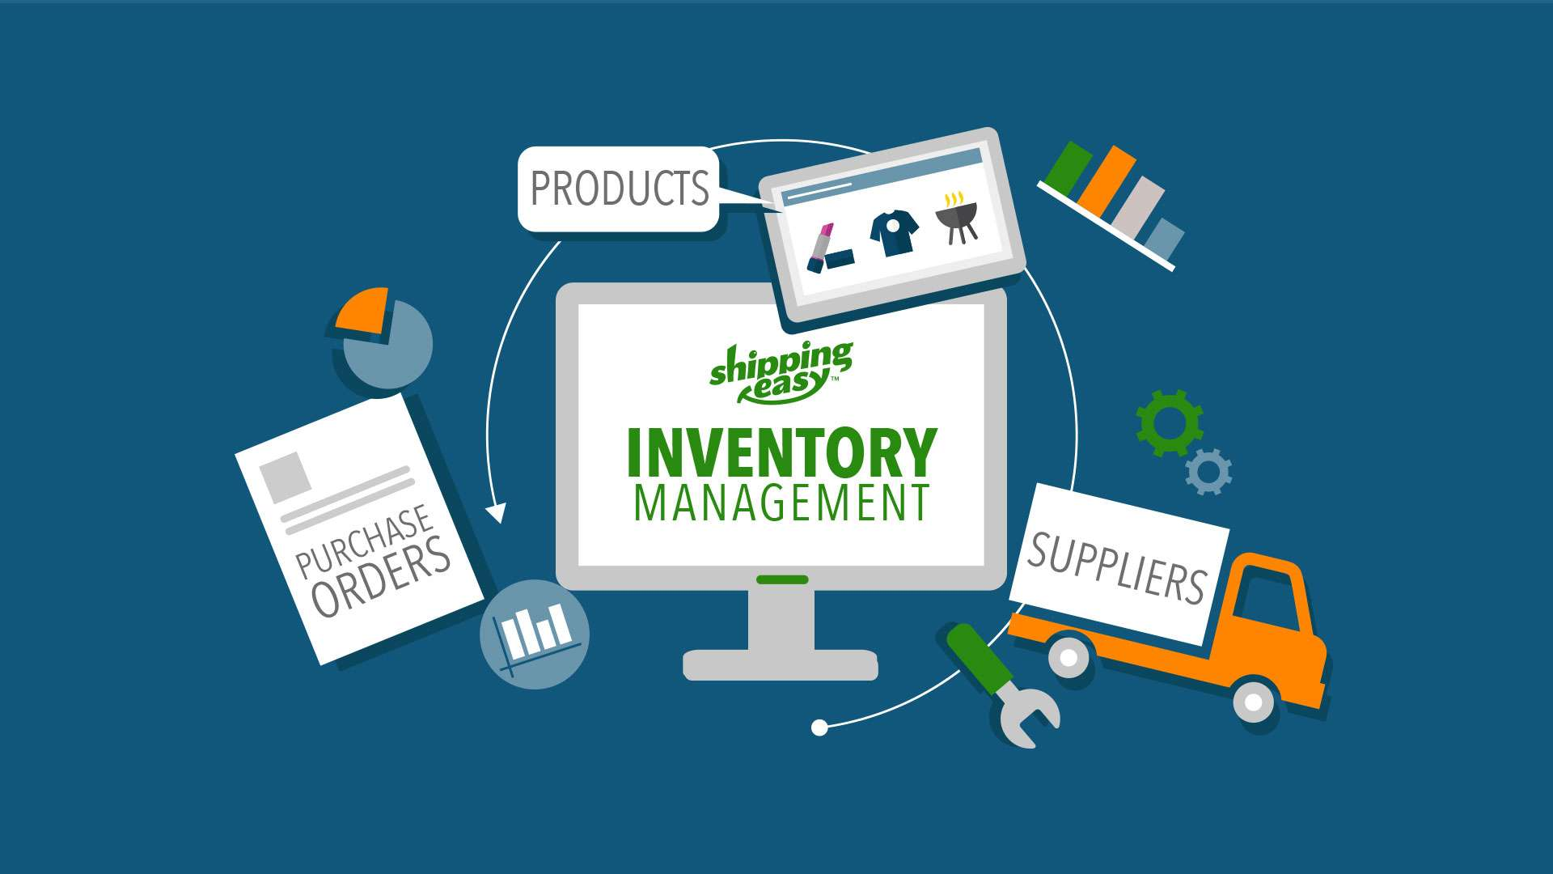
INVENTORY ANALYSIS SOFTWARE
PRESENTED BY –
Kella Gowthami
Sushree Ranjita Panda
Medi Bhargavi
Parimala Rani Nadigatla
Sravya Bandaru
GUIDED BY-
BHIMA SHANKAR

Slide 2
Contents
Introduction
Purpose of IAS
Data Flow Diagram
Functions
Non-functional Requirements
Conclusion
Advantages of IAS

Slide 3
Introduction to IAS
It is used for tracking inventory levels , stocks, and sales.
Company’s use inventory software analysis to avoid product over stock and outages.
In this project work, we developed a IAS to manage customers & resolve the issues raised by the customer.
Here, the database of the customer is managed by User.
Inventory Analysis Software(IAS) has become an important factor in business field.

Slide 4
Cont...
The IAS can enter customer details into the database for both new customers and existing customers.
The IAS is also responsible for modify the database of customer.
The user enters the IAS by using the username & password.
The User can add, update and delete their own request.

Slide 5
Purpose of IAS
The purpose of this document is to show the requirements for the Inventory Analysis Software.
This application allows the IAS to add new products, update the products details and delete the products details.

Slide 6
Advantages of IAS
IAS provides Data Security.
Increased efficiency.
IAS solutions empower you to manage customer projects effectively.
IAS updates the data of product and sales.
IAS systems give you end-to-end case resolution data on a single platform.

Slide 7
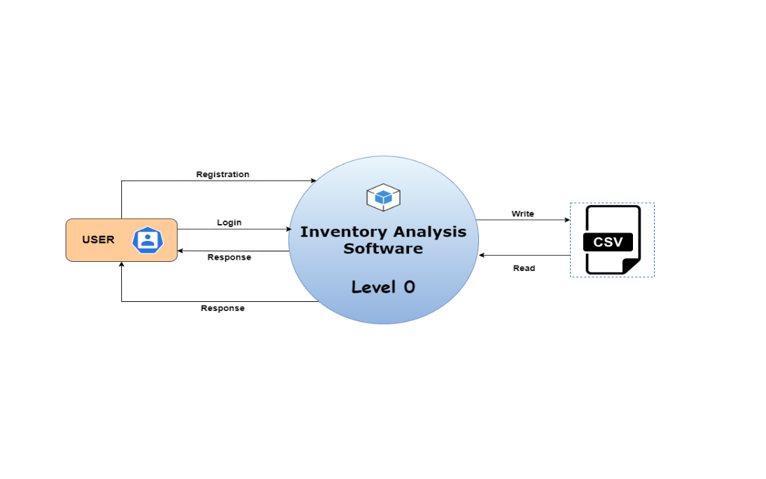
Data Flow Diagram

Slide 8
Functions
1. Options: This is the menu level function for the user to choose the options for adding, deleting, updating the products.
2. Register: This is the menu level function for the user to choose the options for registration by creating the user-ID and password
3. login : This is the menu level function for the user to choose the options for login.

Slide 9
Contd...
4. Menu : This is the menu level function for the user to choose the options for entering into the menu of products, sales, display products, load products, display sales.
5. Options: This is the menu level function for the user to choose the options for entering into the sub menu of the products, sales.
6. product : This the main menu function which defines product details.
7. product_ Options : This the main menu function which includes add product, display product, update product and delete product.

Slide 10
Contd...
8. Add _Product: This is the menu level function for the user to choose the options for adding the new products by entering the product id, name, description, quantity.
9. Update _Product : This function is used to update product by entering the name, description and quantity.
10. Show_Product : This function displays the product details.
11. delete_ product : This function deletes the product by entering product id.

Slide 11
Contd...
12. Sale : This is the menu level function for the user to choose the options for sale of the product.
13. Sale_ Options : This is the menu level function for the user to choose the options for sale for make a sale and display the sale.
14. Sale_ display : This is the menu level function for the user to choose the options for display of sale to see the status of the products that sold.
16. sale_ Report : This is the sub level menu function for the user to choose the options for seeing the complete report of the products.
15. product_ Report : This is the sub level menu function for the user to choose the options for seeing the complete report for the sale of the products.

Slide 12
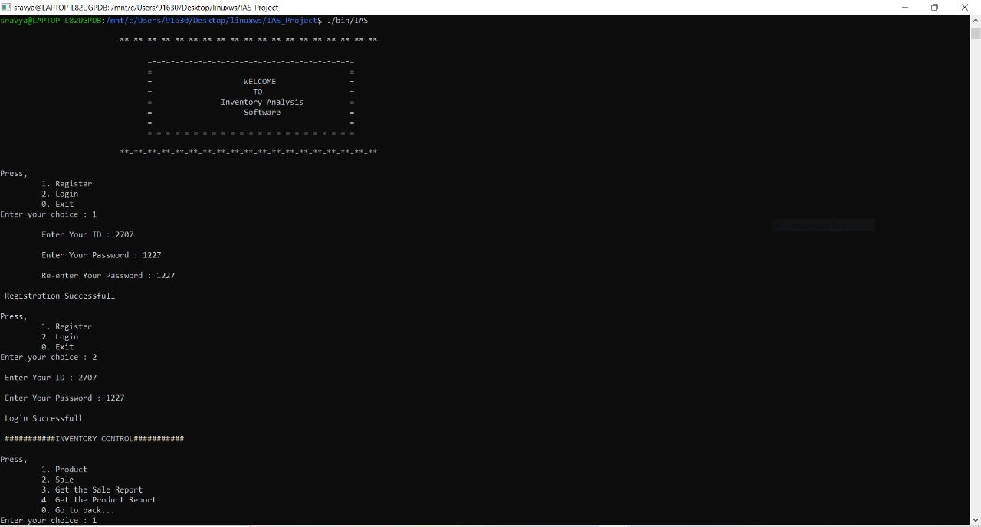
OUTPUT SCREEN

Slide 13
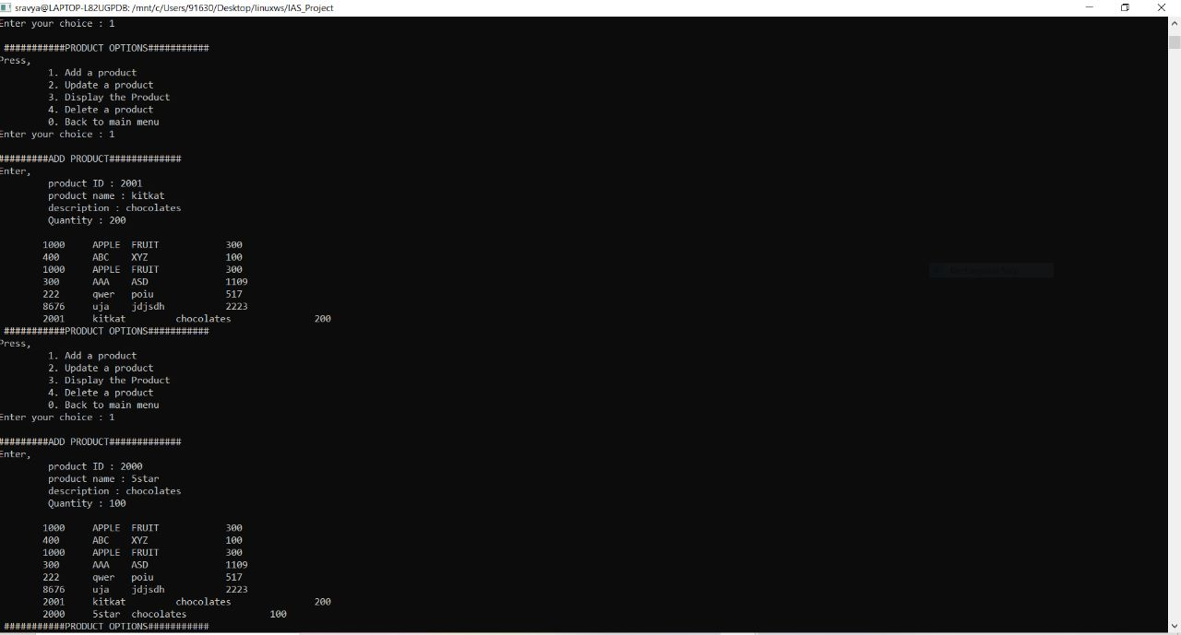
CONT…

Slide 14
CONT…

Slide 15

Non-Functional Requirements
● Makefile:- It is a way of automating software building procedure and other complex tasks with dependencies.
● It is a set of commands with variable names and targets to create object file and to remove them.
● Valgrind:- To detect memory leaks.

Slide 16
Conclusion
This application allows the IAS to add new products, update and delete the product details. It can make sale, get the sale report and product report.
The system generates a report which shows total number of products that are purchased on the specified date, time and month.

Slide 17
GITHUB LINK
https://github.com/ranjita1307/IAS_Group5.git

Slide 18

Thank You....

